Slide 1
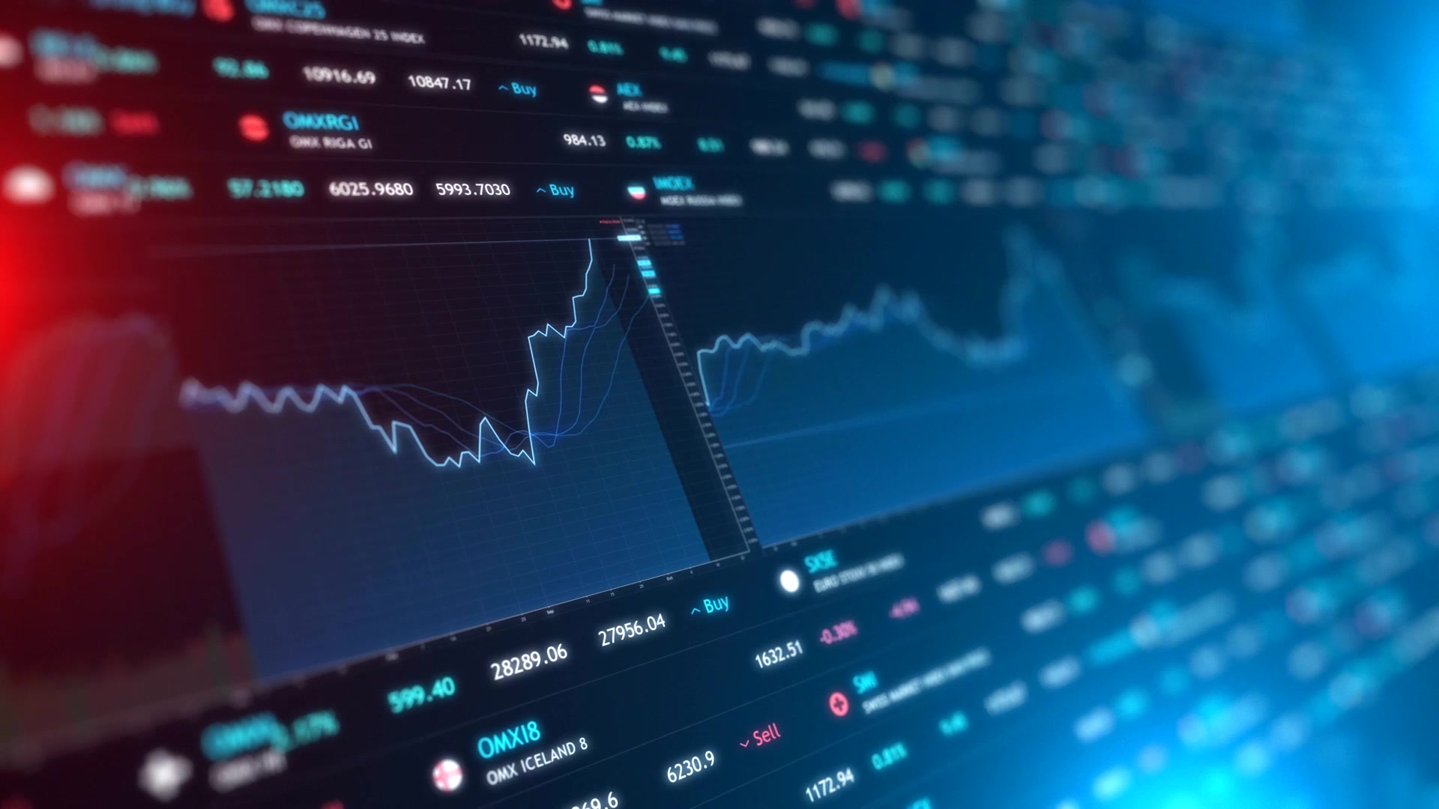
Stock Market Performance of Food and Beverages Sector During COVID-19
Bensy Chitteth
Kalpesh Odedra
Sreeja Thazhathethil
Thy Pham
Yagna Himachalapathy

Slide 2
Agenda
Background
Objective
Methodology
Data Analysis
Results
Recommendations
Conclusion

Slide 3
Background
The Food industry is one of the most important industries that contribute to economic development. The pandemic had an impact on the whole process from the field to the consumer. .
As Coronavirus continues to expand globally, affecting nearly every country, the food and beverages which is one of the most crucial industries also received negative impact.
As governments closed restaurants and bars to encourage social distancing, restaurant daily traffic has plummeted all over the world, when compared to the same period in 2019.
Restaurant closures had a knock-on effect on allied industries like food production, liquor, wine, and beer manufacture, as well as food and beverage transport.

Slide 4
Objectives
Research Objectives:
Analyzing and understanding the stock market performance of the Food industry during the first and second waves of COVID-19.
Research Questions:
What is the company's stock price, and does it vary in terms of selling volume?
What is the relationship between the companies that were chosen, and how did their services differ significantly in terms of consumer stock?
How can businesses return to their preliminary ways of functioning?

Slide 5
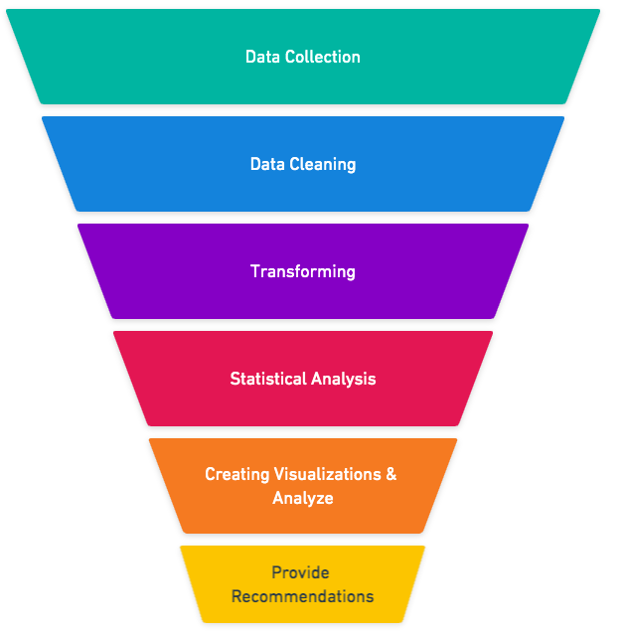
Methodology
Yahoo Finance is a popular website that offers financial news, data, and analysis, as well as stock quotations, press announcements, financial reports, and original content. (“Yahoo Finance – Wikipedia").
Python and Excel was further used for cleaning, transforming, and visualizing. The results were then interpreted to provide recommendations.
Notes:
https://whimsical.com/data-analysis-LUub1yxMqJLqvqopAUgt1x

Slide 6
Data Analysis
15 Chosen companies for Analysis:
UL: Unilever PLC,
PEP: PepsiCo, Inc.,
K: Kellogg Company,
KO: The Coca-Cola Company,
NSRGF: Nestle S.A,
HINKF: Heineken N.V.,
HSY: The Hershey Company,
CAG: Conagra Brands, Inc.,
TSN: Tyson Foods, Inc.,
KHC: The Kraft Heinz Company,
STBFY: Suntory Beverage & Food Limited,
BUD: Anheuser-Busch InBev SA/NV,
MDLZ : Mondelez International, Inc.,
CPB: Campbell Soup Company,
AJINY: Ajinomoto Co., Inc.

Slide 7
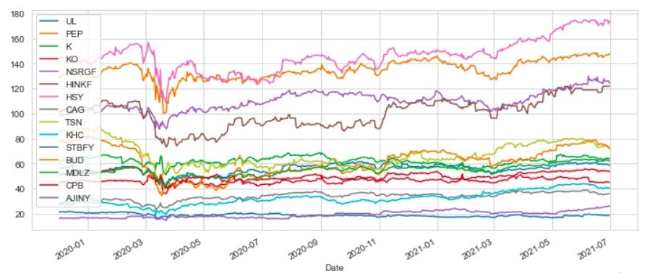
Data Analysis
Trend Analysis
Stock Price
During the 1st wave (1/01/2020-30/06/2020), the stock price for all the companies was initially low in Jan 2020 but later in the mid of Jan 2020 there was a rise in price.
When there was the official announcement of COVID-19, the prices suddenly decreased at the end of Mar 2020 and increased again in April 2020; but gradually the was again a decrease in price between May 2020 and Jun 2021 with slight fluctuations.
Notes:
From the trend chart of stock prices, we can see that almost all companies had a huge dip in their stock prices during march of 2020. This aligns with covid-19 situation increasing
In north America, right around this period.
The Hershy Company had the biggest dip in prices followed by Tyson foods.
However, stock prices bounced back quickly and gradually increased to about their original price points.

Slide 8
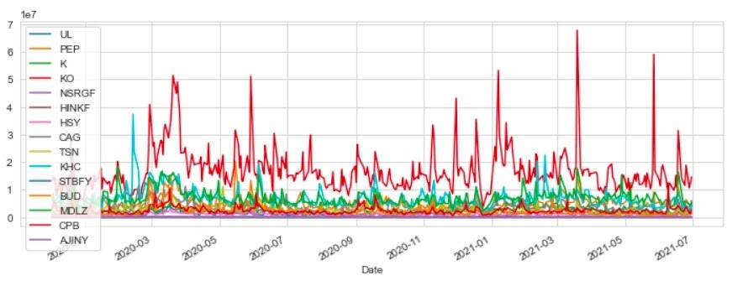
Data Analysis
Trend Analysis
Stock Volume
The stock volume shows a major fluctuation at the same level between the timeframes.
In the 2nd wave (1/07/2020-31/06/2020), the stock volume of the selected companies increased between Jul 2020 and Dec 2020 whereas the stock volume like that of the first wave shows a major fluctuation at the same level between the timeframe as well.
Notes:
When we look at volume of stocks for this period, it shows a much clear picture of how volatile the market was for the food and beverage industry.
Almost all companies had high stock volume volatility in trading througout the period of study. Coca Cola and Pepsi were among the most volatile.

Slide 9
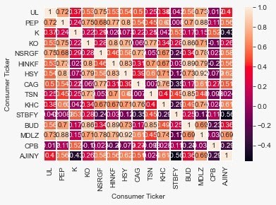
Data Analysis
Correlation Analysis
The heat map shows that there is a strong correlation between MDLZ & HSY, BUD & HINKF, MDLZ & PEP, BUD & KO, BUD & TSN, HSY & HINKF, HSY & PEP, and HINKF & KO.
A weak and negative correlation between AJINY & K, AJINY & STBFY, STBFY & CAG, CPB & AJINY, and STBFY & KHC.
The weak and negative correlation may be because of the variation in the products or business.
Notes:
Correlation of stock prices help us club companies together which had similar movement of prices.
Since all the companies are from food and beverage, we don’t have high negative correlation but there are a lot of combinations of strong positive correlation.
Like Budlight and Hineken with 0.8. Both of these companies have similar products, which can be the reason for similar movement of strock prices.
But a lot of other combinations are from companies with a variety of food products in their arsnal. But the movement can be attributed to the challenge of chaning mode of delivery and chain supply of products.

Slide 10
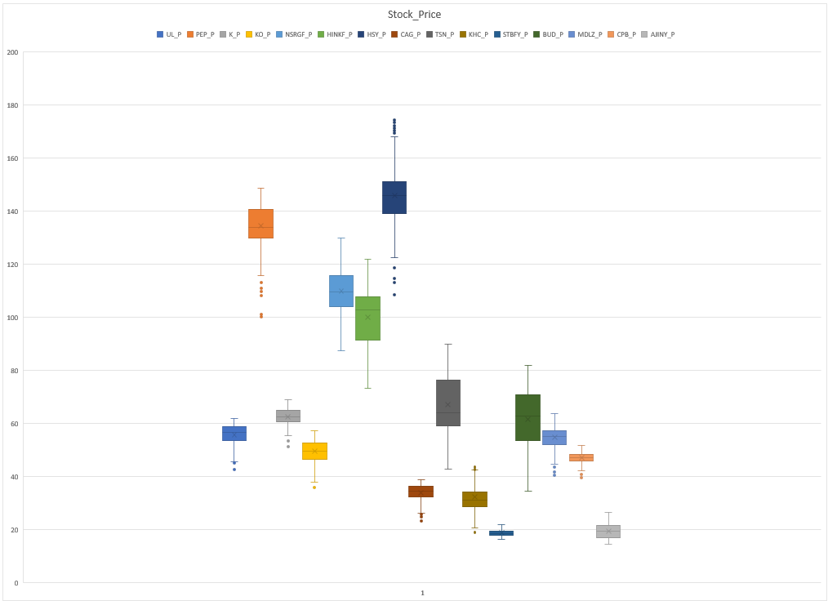
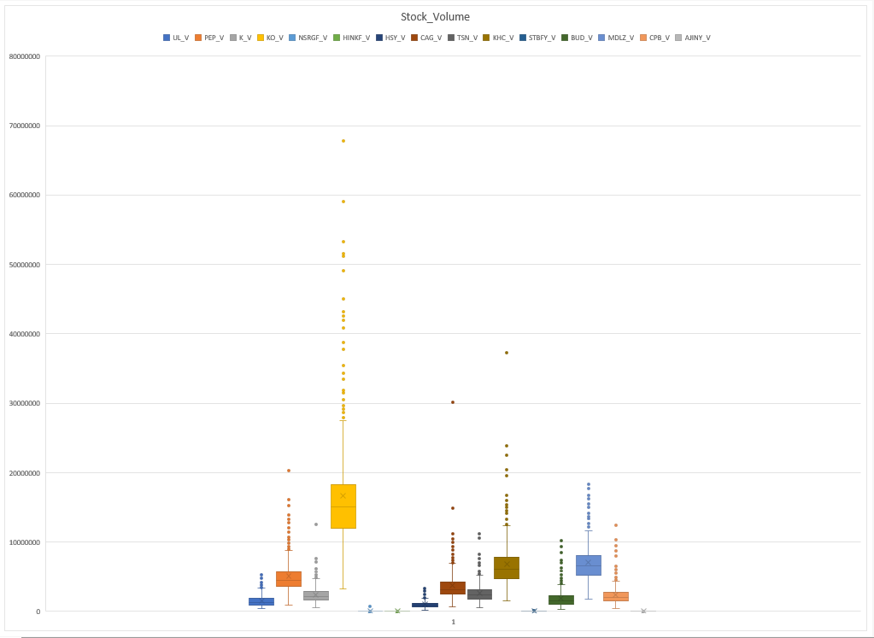
Data Analysis
Outliers
Notes:
This volatility can be further apparent when we look at box plots of individual companies.
For stock prices, all the companies selected have atleast a few lower end outliers. this can be attributed to the dip in march. However Hershey even had outlier on the upper end, which speaks more to the volatility of the market.
Box plots of stock volume makes this even apparent since all the selected companies have multiple outliers. Coca Cola and Pepsi co had the most outliers.

Slide 11
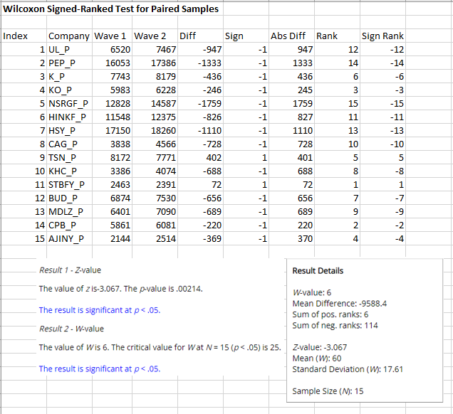
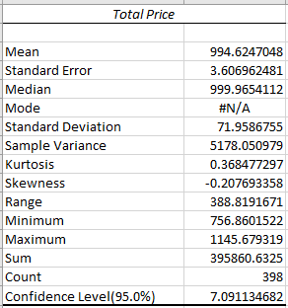
Data Analysis
Descriptive Statistics
Wilcoxon Signed-Ranked Test
Notes:
Wilcoxon Signed Rank test
Non parametric test to find if there is similarity or difference between two samples.
Dividing stock prices between two waves, period of 6 months.
Result: p value suggest we can reject the null hypothesis, that bot samples are from same population. Therefore there is a significant difference between the price movements of two waves.
High sum of negative ranks , suggest prices of second wave were more than that of first wave.

Slide 12
Results
Trend Analysis of stock volume provides an insight on how volatile the inter-day trading was for each of the selected companies.
Correlation analysis shows how companies with similar types of products have the same movement of stock prices. Hence, it was important for companies to modify their business model.
Wilcoxon signed rank test indicate how the stock prices in the second waves are significantly higher than the first, showing that even the dip in prices were historically high, most companies recovered and there wasn't that big of dip in prices during second wave

Slide 13
Conclusion
The trend analysis shows the dip of the selected companies in March 2020 during the first wave of Covid-19. The Hershey company experienced the highest dip compared to other selected companies followed by Tyson Foods Inc. The trends in stock volume gives an overview of how volatile the inter-day trading was for each of the selected companies. The coca cola company topped among all other companies with most volatility followed by Kraft Heinz company.
Correlation analysis shows how companies with similar types of products have the same movement of stock prices. Wilcoxon signed rank test indicate how the stock prices in the second waves are significantly higher than the first, showing that even the dip in prices were historically high, most companies recovered and there wasn't that big of dip in prices during second wave. This might be since the companies and public had time to adjust to Covid-19 crisis and therefore there wasn't as much of panic during second wave.
Overall, the study shows that Covid-19 crisis had an adverse effect on the entire food and beverage industry where the stock volume had major fluctuations in size whereas the stock price increased gradually. Despite the fact that few issues have been identified in the food industry thus far, the future remains unknown. As a result, each country must recognize the gravity of the situation and may need to tighten or loosen restrictions in response to the pandemic's progress.

Slide 14
Recommendations
Modifying Business Models
Discounts, Offers, Coupons
RFM Analysis
Online Services
Text and Sentiment Analysis

Slide 15
Thank You

